Slide 1

ACADEMIC WRITING AND SCHOLARSHIP SSGC8807
Or, Why We Write
Richard Fitzgerald

Slide 2
Outline Ooo you made it! Now some new things about working in a University you might not know.
Part 1
Introduction 1. Who am I and who are you?
The Course
Introductions 2. Academic Researcher, Who are you, what are you researching?
Part 2
What are we doing here, academia and doing a PhD.
Choosing to be a writer. Why I write . Goal, Motivation, Desire, Why do you want to do this as a career.
Part 3.
Being a Researcher in a global research environment.
Know your research community.
Google Scholar, Academia.edu, ResearchGate.

Slide 3
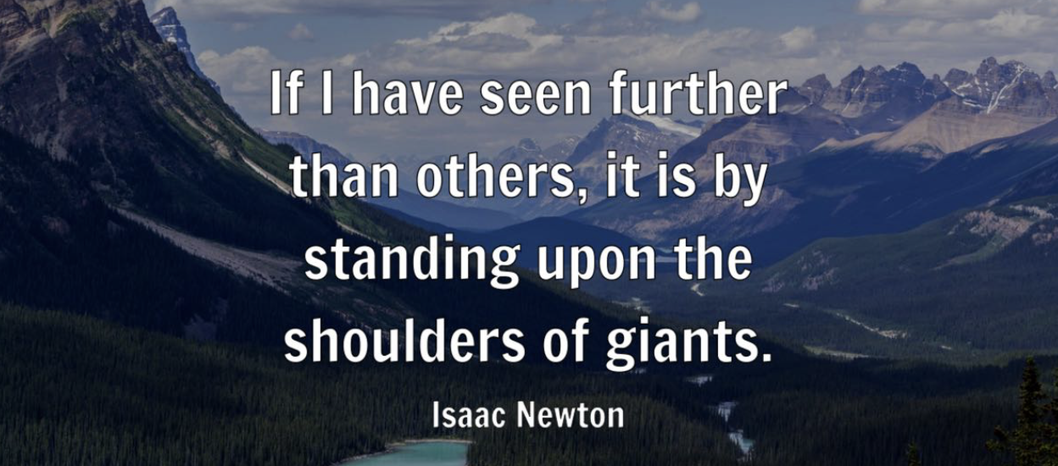
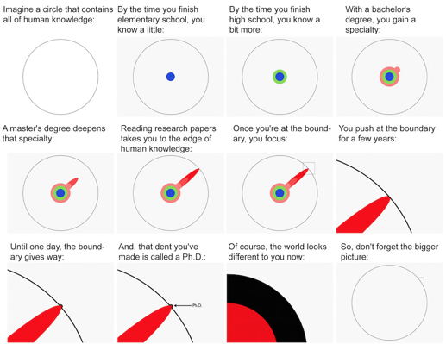
What is a PhD?
A contribution to new knowledge.
But how do you actually contribute to new knowledge?

Slide 4

Writing as an Academic Career.
But how will people know about your contribution given your PhD is read by only 3 – 4 people?
The PhD is only the first step, after or even during your PhD you then need to gain a wider audience of your peers.
It might be a great piece of research but if no one reads it does it exist? Not in academia.
You need to publish your research to gain a wider audience. And keep publishing to get your ideas taken seriously and to influence others research.
Writing, then, will remain the core activity during your academic career.

Slide 5
Part 1.
Part 1
Introduction 1. Who am I and who are you?
What is this course about?
Introductions. Academic Researcher, Who are you, what are you researching?

Slide 6
My Research Life
PhD Method in Media Interaction. (1999) University of Wales Bangor.
Two main areas of research. Media Discourse Analysis, Qualitative Methodology.
Around 100 Academic Publications.
Former Editor of the journal Discourse, Context and Media (SSCI)
Supervised 8 Phds to completion.
(soon to be TWO more in 2023, fingers crossed)

Slide 7
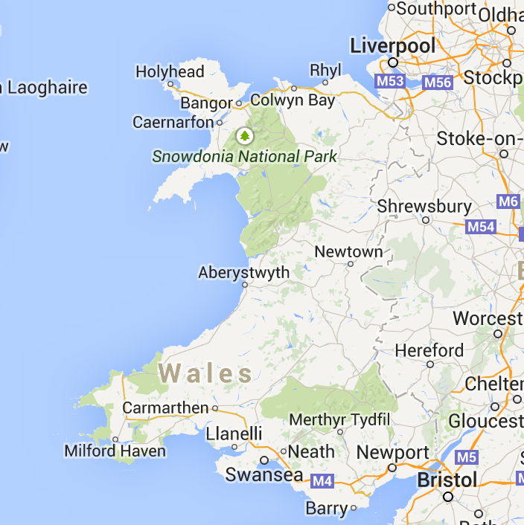
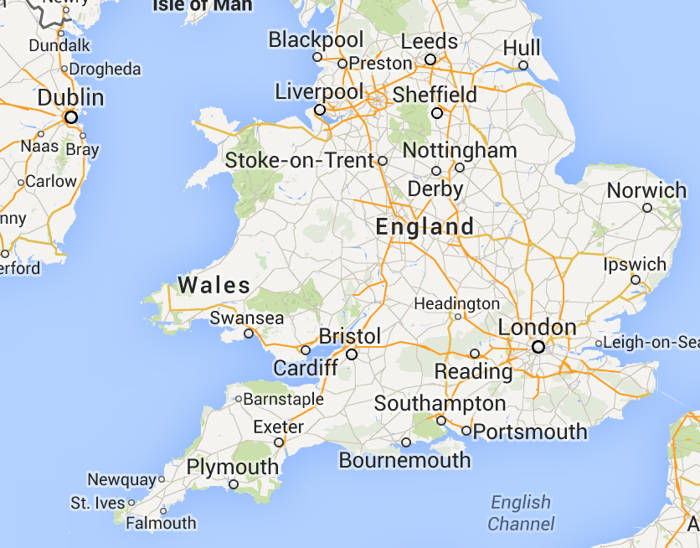
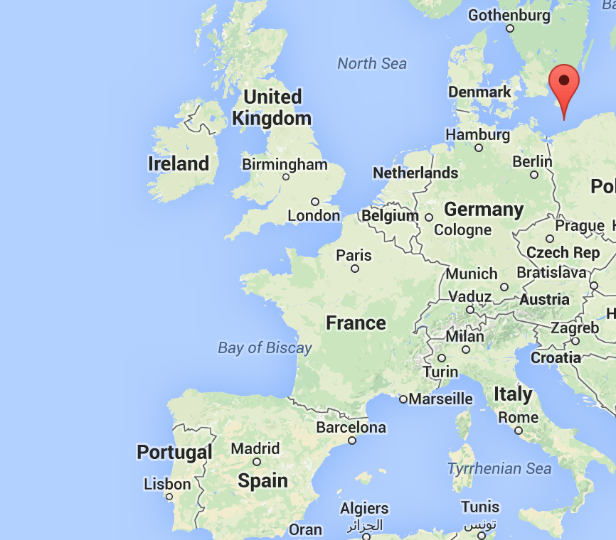
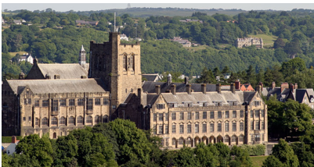





Richard Fitzgerald
Undergraduate. 1990-1993
Dip Research Methods – 1993-1994
PhD – 1994-1999.
Wales Bangor, Cardiff University, UK Sociology and Media Communication

Slide 8
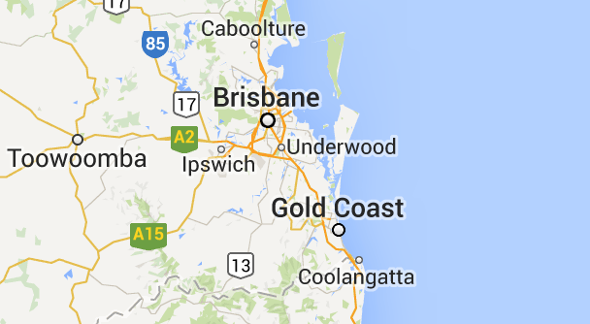
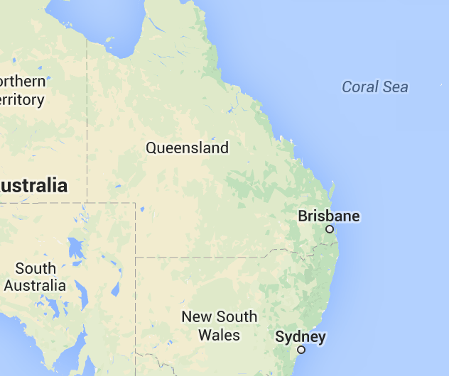
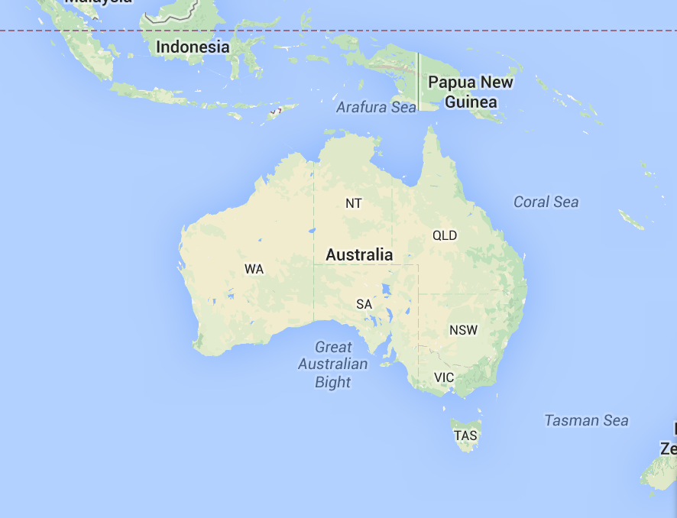
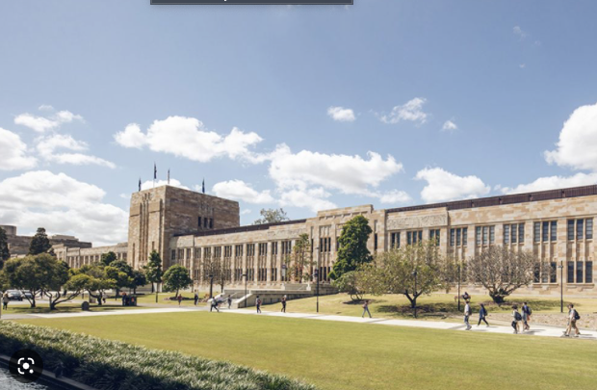
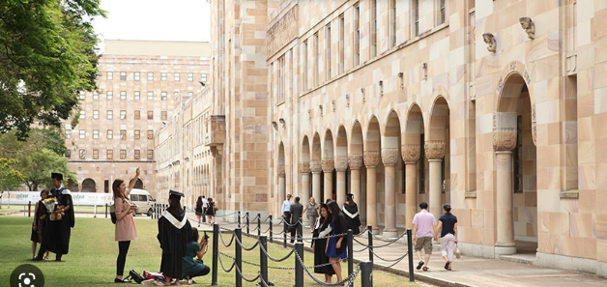



Australia, Brisbane: University of Queensland
English, Journalism and Communication

Slide 9
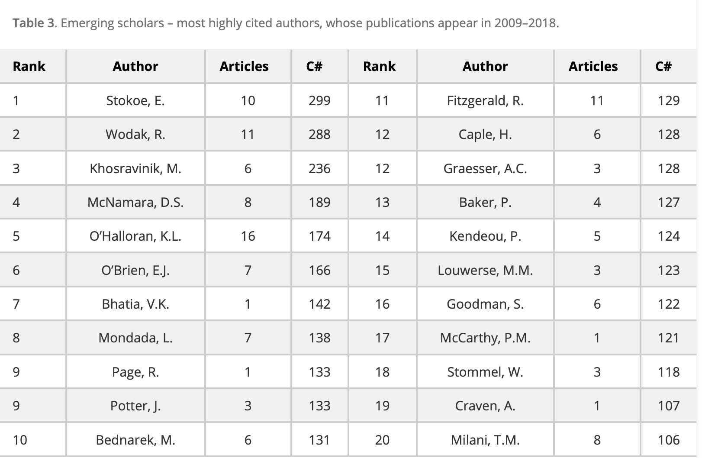



The Academic Vainglorious 1.
Around 100 publications, SSCI and Edited Books
Recent publications
Journal editing
Invitations and Talks
For instance, Majid Khosravinik, Danielle McNamara, Kay O’Halloran, Edward O’Brien, Vijay Bhatia, Lorenza Mondada, Ruth Page, Johnathan Potter, Monika Bednarek, Richard Fitzgerald, Helen Caple, Paul Baker, Panayiota Kendeou, Max Louwerse, Simon Goodman, Philip McCarthy, Wyke Stommel, Alexandra Craven and Tommaso Milani, to name some prominent ones, steadily gained impact in the field.
It is safe to state that the rising scholars may reflect a shift of research focus onto multimodal analysis, social media, membership categorization analysis, digital conversation analysis and discursive news values approach, as indicated by the main research areas of those emerging scholars.

Slide 10

Journal Editor of DCM 2018-2021
SSCI
400 Submissions a Year
Acceptance Rate 12%
Various Talks, and Presentations, many in China, about Academic Publishing.
19th January. Pre Workshop on Academic Publications - MEDCOM 2023 (Online)
The 8th World Conference on Media and Mass Communication 2023

Slide 11
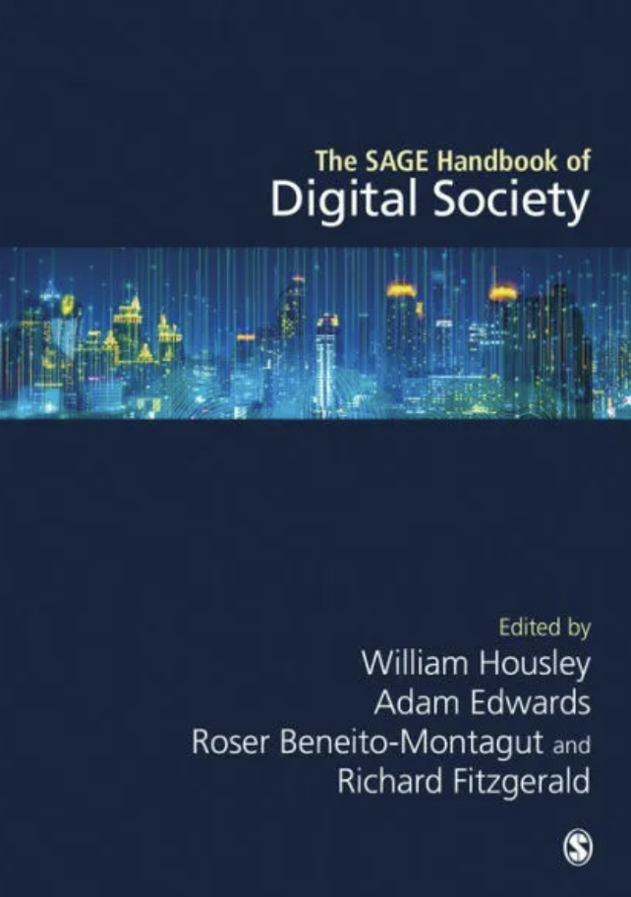
Recent Publications
Peer Reviewed Journal Articles/Book Chapters and Books
2023
Housley, W, Edwards, A, Benieto-Montagut, R Theorizing Digital Society (2023) Housley, W, Edwards, A, Roser, B, Fitzgerald, R. (Eds). Handbook of Digital Society. Sage
Edwards, A, Housley, W, Benieto-Montagut, R (2023) Digital Society and Smart Cities (Housley, W, Edwards, A, Roser, B, Fitzgerald, R. (Eds). Handbook of Digital Society. Sage.
2022
Au-Yeung, T, Fitzgerald, R (2022) Time and multimodality in ethnomethodological and conversation analysis studies of practical activity. Sociological Review. (SSCI)
Au-Yeung, T., Fitzgerald, R. (2022). Multi-layered gestalt in real-time interaction. Special Issue Philosophical Psychology and Praxeological Gestalts. Social Psychology and Sociology in dialogue with the Philosophers of Gestalt Psychology. Philosophia Scientiae. (Scopus)
Fitzgerald, R., Sandel, T., & Wu, X. (2022). Chinese social media: Technology, culture and creativity. Discourse, Context & Media, 48, 100610. (SSCI)
Rautajoki, H, Fitzgerald, R. (2022) Populating ‘Solidarity’ in Political Debate. Interrelational Strategies of Persuasion within the European Parliament in the Aftermath of the Brexit. Journal of Language and Politics (SSCI)
Talib, N, Fitzgerald, R. (2022) The Art of Illusion as Government Policy. Analysing Political Economies of Surrealism. Critical Discourse Studies (SSCI)

Slide 12
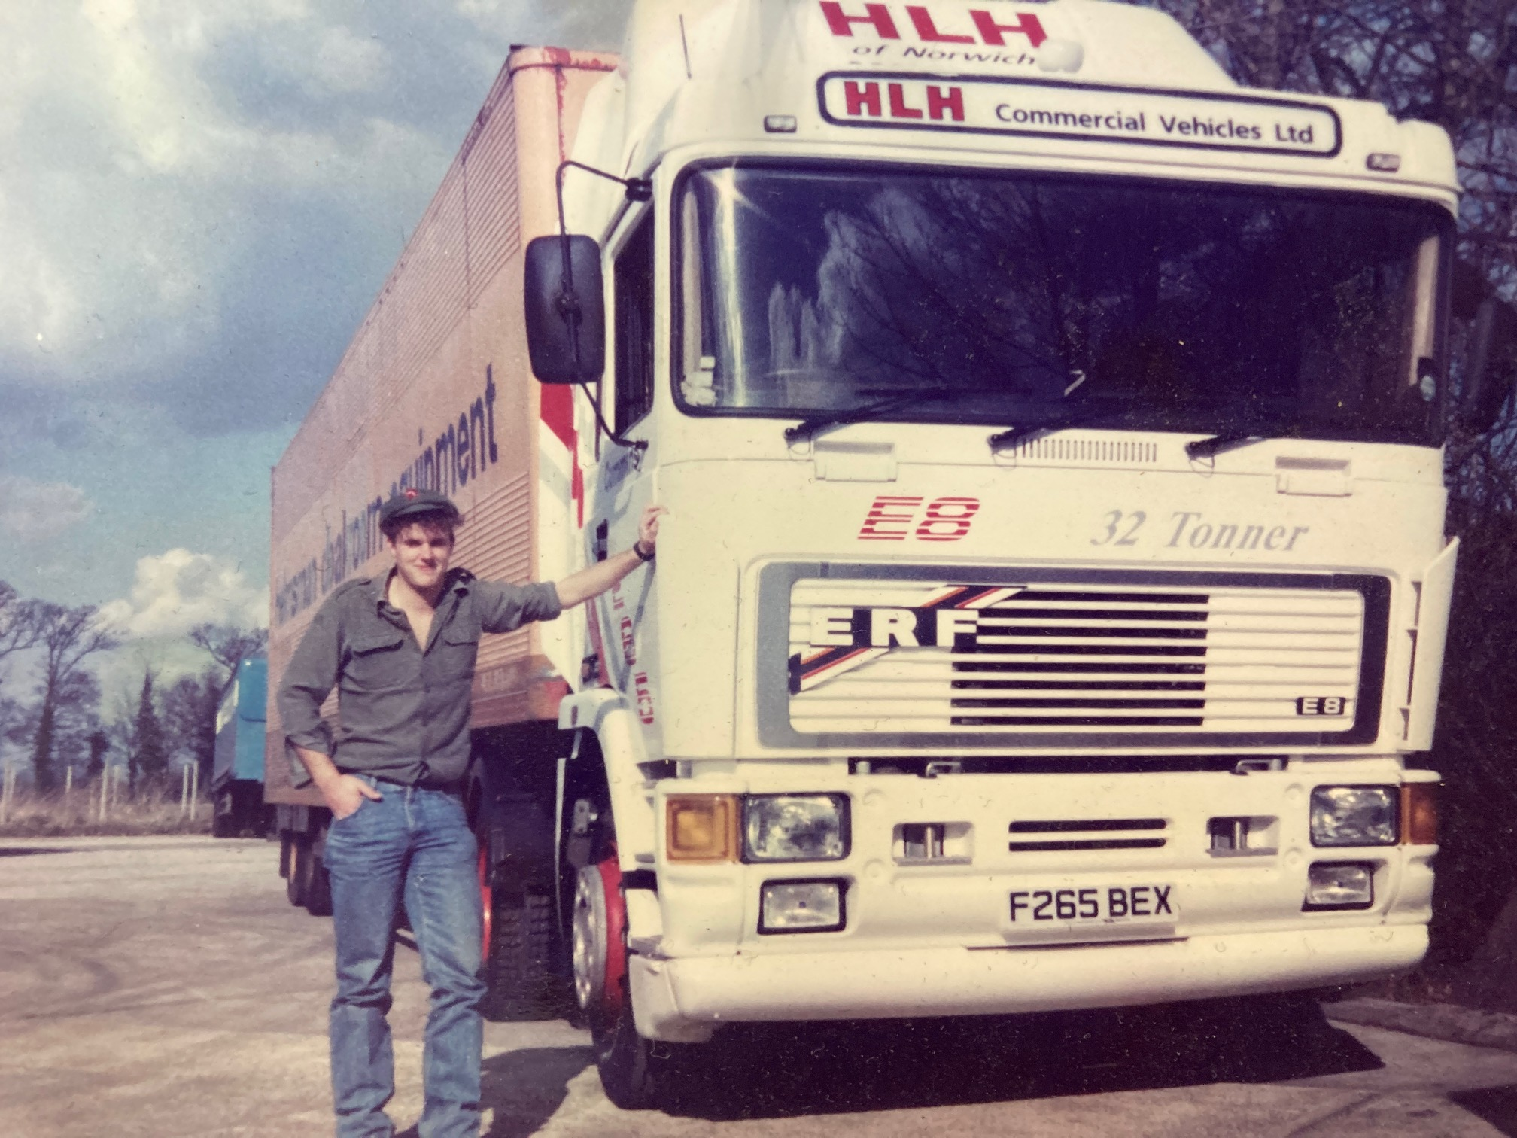

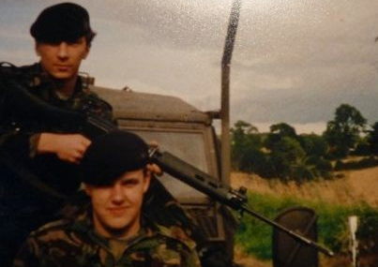
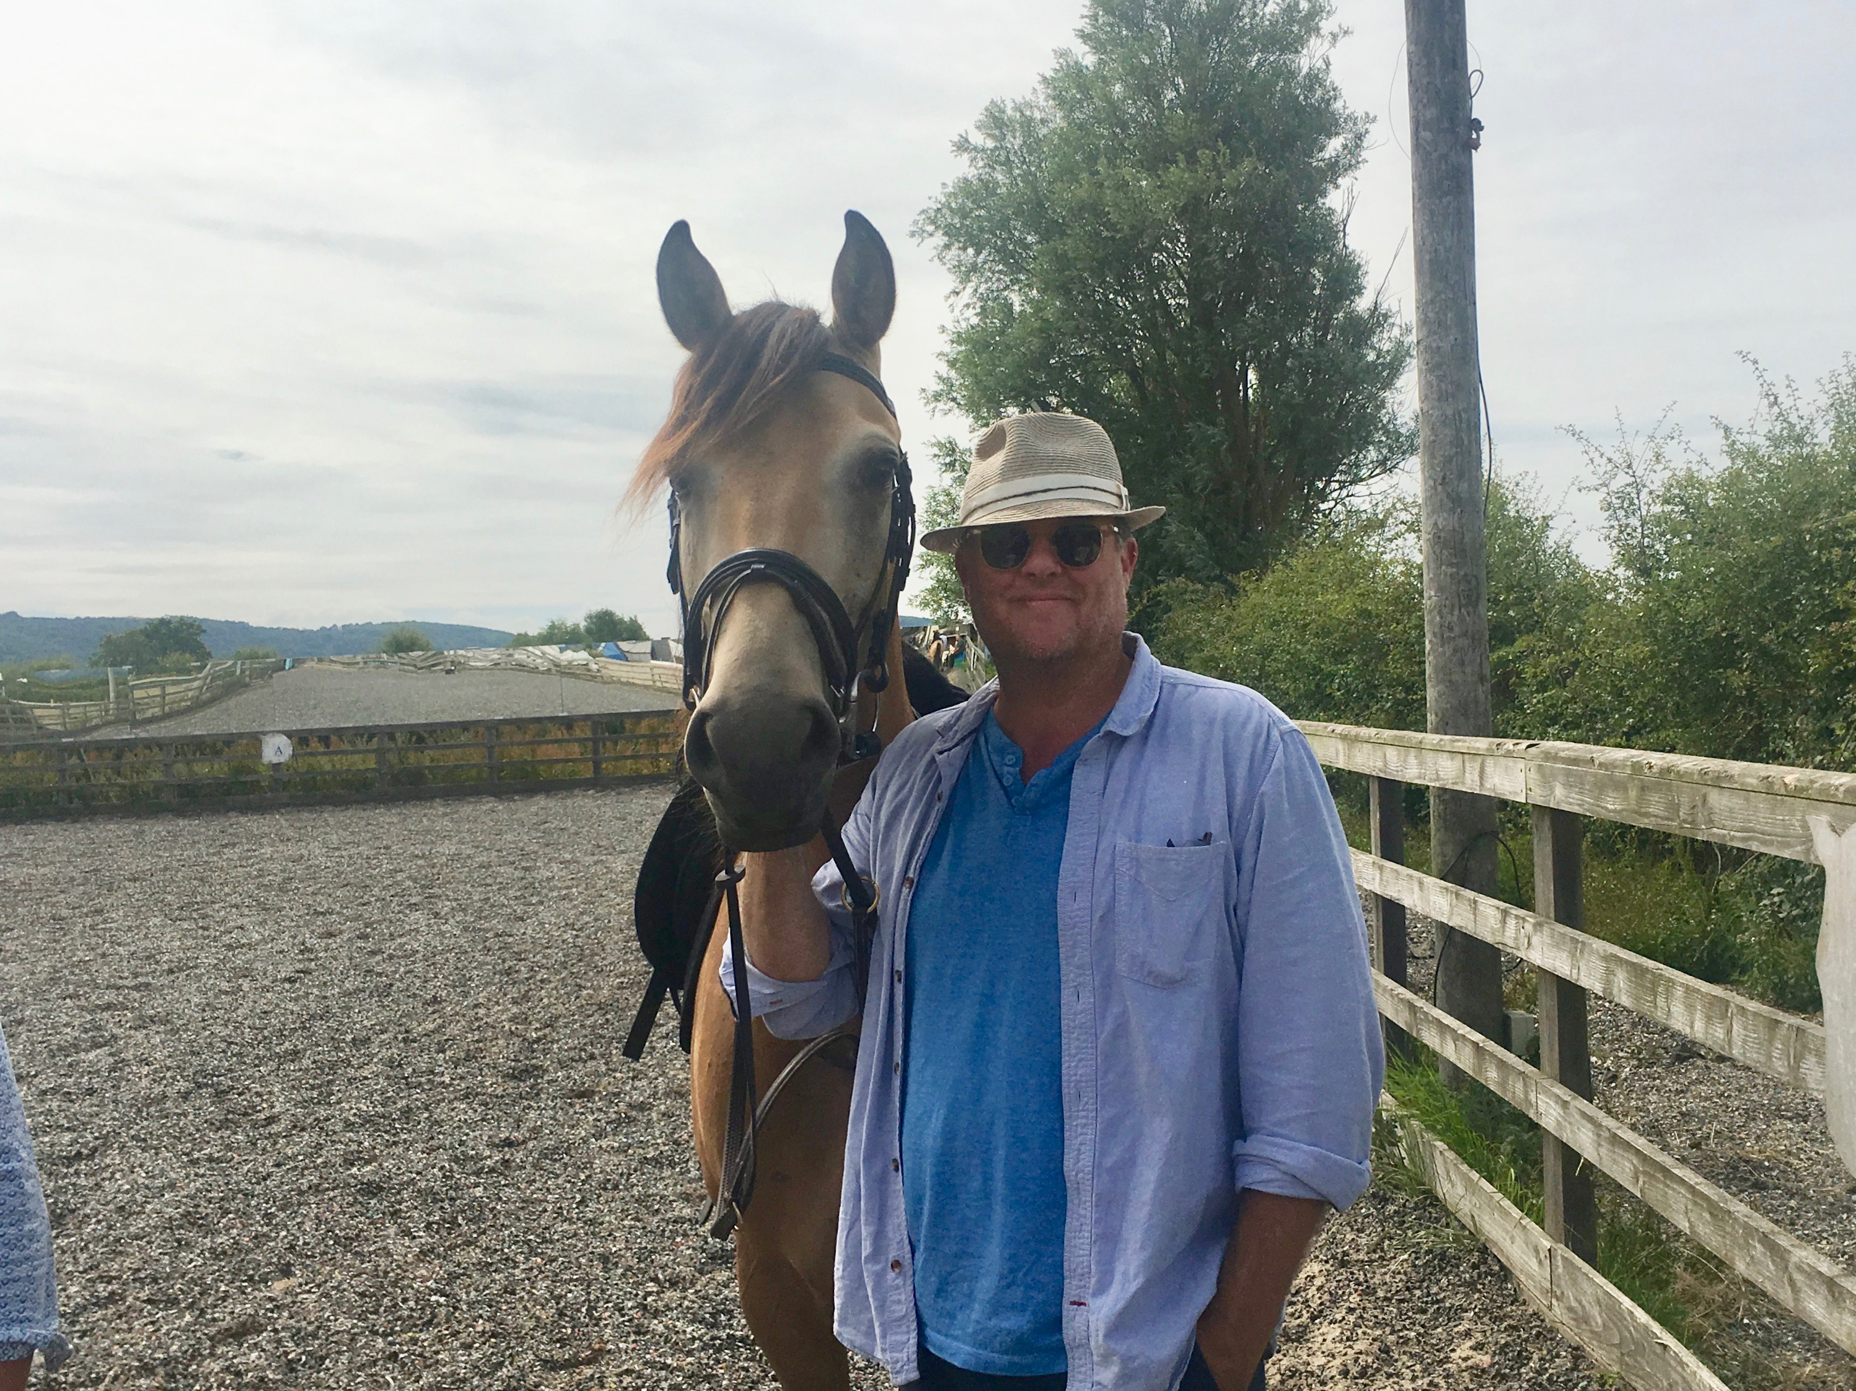
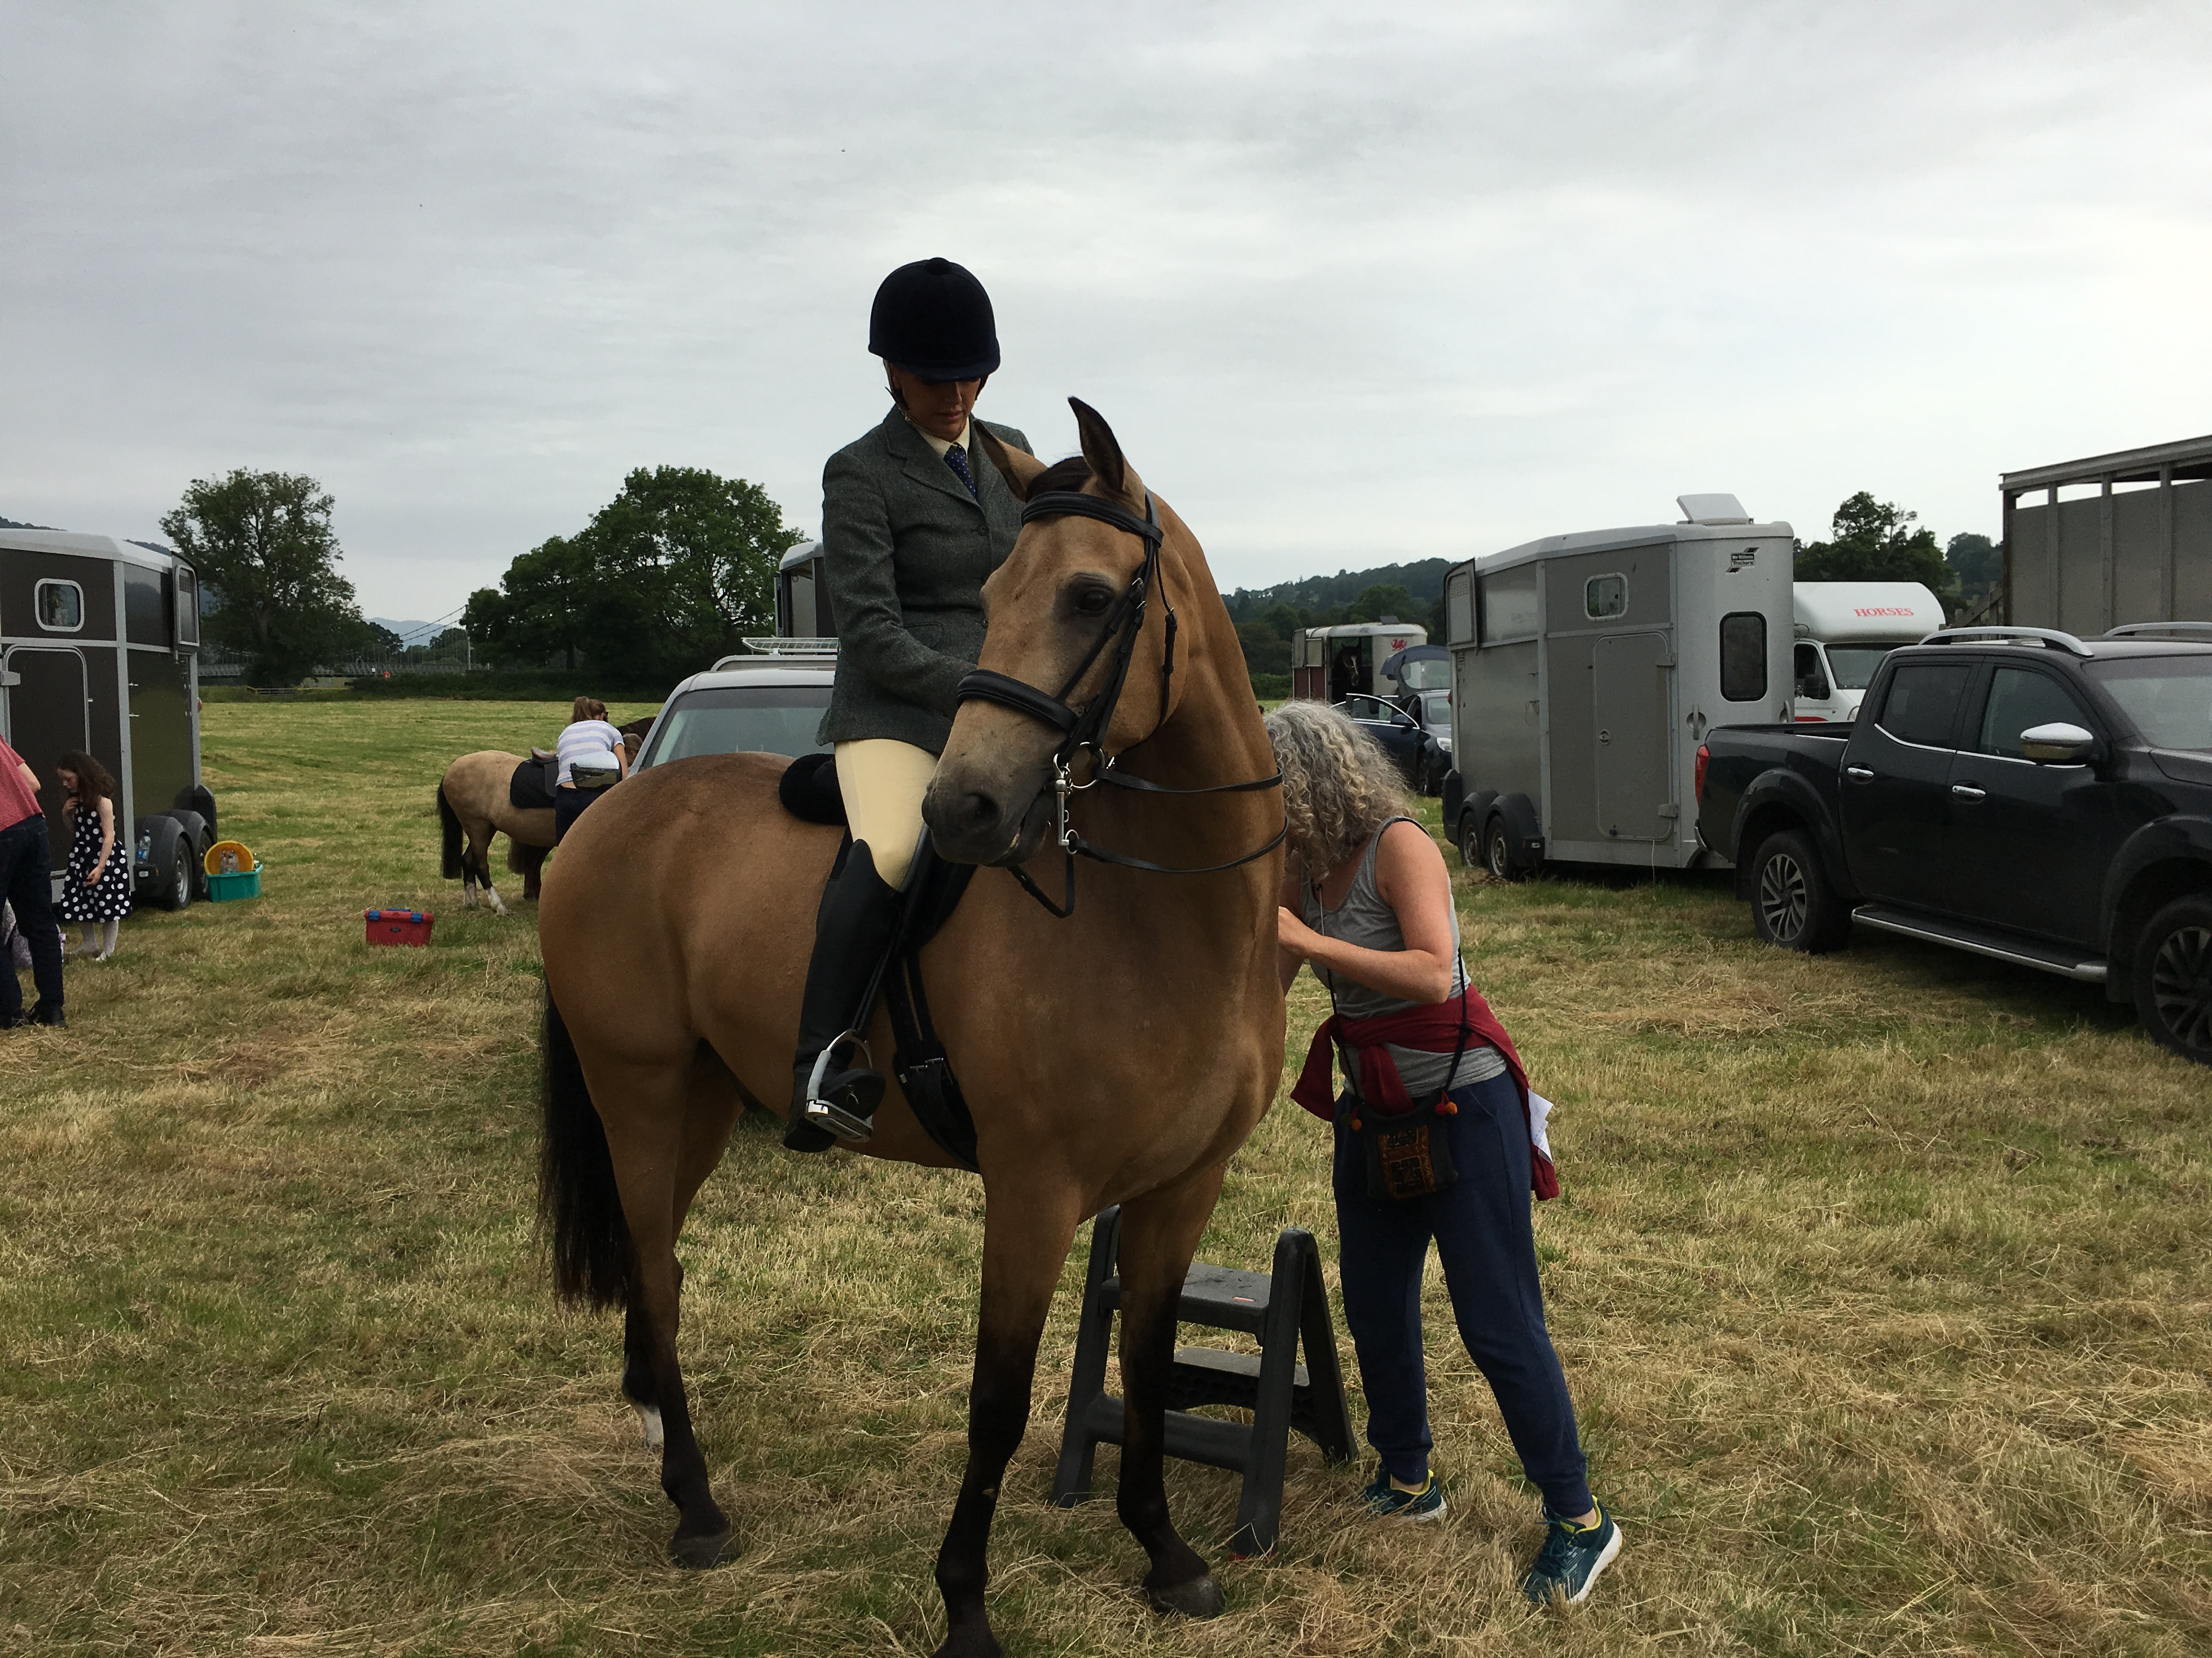
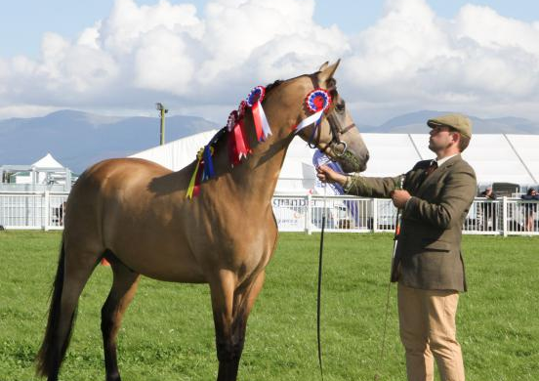
Not Everyone Begins as an Academic – and it’s always good to have a hobby

Slide 13


You and the Course
Who are you and what Dept you are working in.
So, what is this course about?

Slide 14

Who are you. 2, and what kinds of research are you interested in.
In deciding to do a PhD you are making a decision to be a writer, first for a PhD and then research articles/chapters/books.
The university you work at will expect this, will hire you on the basis of this, promote you on the basis of how well you do this and how well known your writing/research is globally.
From now until you stop working in a university you will be thinking about writing or writing something.
You will be your research publications.

Slide 15

Part 2 Why do this?
Writing as a career.
Why I write
Goal, motivation, drive desire, what do you want to achieve?

Slide 16
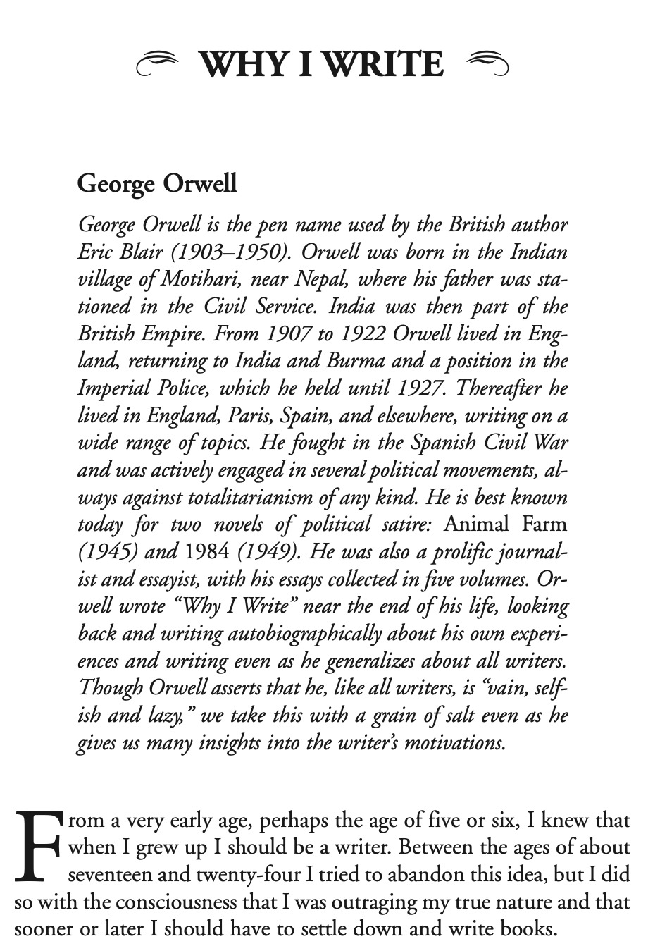

Slide 17
George Orwell. Why I Write.
All writers are vain, selfish and lazy, and at the very bottom of their motives there lies a mystery. Writing a book [or article] is a horrible, exhausting struggle, like a long bout of some painful illness. One would never undertake such a thing if one were not driven on by some demon whom one can neither resist nor understand.

Slide 18
[There] exist in different degrees in every writer, and in any one writer the proportions will vary from time to time, according to the atmosphere in which he [sic] is living.
1. Sheer egoism.
Desire to seem clever, to be talked about, to be remembered after death, to get your own back on grown-ups who snubbed you in childhood, etc. etc. It is humbug to pretend that this is not a motive, a strong one. Writers share this characteristic with scientists, artists, politicians, lawyers, soldiers, successful businessmen—in short, with the whole top crust of humanity. The great mass of human beings are not acutely selfish. After the age of about thirty they abandon individual ambition—in many cases, indeed, they almost abandon the sense of being individuals at all—and live chiefly for others, or are simply smothered under drudgery. But there is also the minority of gifted, wilful people who are determined to live their own lives to the end, and writers belong in this class. Serious writers, I should say, are on the whole more vain and self-centered than journalists, though less interested in money.

Slide 19
2. Aesthetic enthusiasm.
Perception of beauty in the external world, or, on the other hand, in words and their right arrangement. Pleasure in the impact of one sound on another, in the firmness of good prose or the rhythm of a good story. Desire to share an experience which one feels is valuable and ought not to be missed. The aesthetic motive is very feeble in a lot of writers, but even a pamphleteer or a writer of textbooks will have pet words and phrases which appeal to him for non-utilitarian reasons; or he may feel strongly about typography, width of margins, etc. Above the level of a railway guide, no book is quite free from aesthetic considerations.

Slide 20
3. Historical impulse.
Desire to see things as they are, to find out true facts and store them up for the use of posterity.
4. Political purpose.
Using the word “political” in the widest possible sense. Desire to push the world in a certain direction, to alter other people’s idea of the kind of society that they should strive after. Once again, no book is genuinely free from political bias. The opinion that art should have nothing to do with politics is itself a political attitude.

Slide 21
The Art of Writing
When I sit down to write a book, I do not say to myself, “I am going to produce a work of art.” I write it because there is some lie that I want to expose, some fact to which I want to draw attention, and my initial concern is to get a hearing. But I could not do the work of writing a book, or even a long magazine article, if it were not also an aesthetic experience.

Slide 22
Why I Write
1. PhD. To prove I could do it, to my family and myself.
Post PhD
I felt I had something to say, to add to the field.
Coming across an interesting phenomena and wanting to tell people about it.
To build upon the area of methodology that I work with
To critique directions in fields
To work with clever people
To critique the powerful
To help other people get their ideas published.
By invitation

Slide 23
Knowing your audience? Who are you writing (this) for ?
Being successful in a global research environment.
Know your research community. Know who you are trying to talk to. Getting noticed.
Google Scholar, Academia.edu, Research Gate.

Slide 24



The Academic Global Environment. Finding your people, following your people, know your audience. Find your Supervisor and your peers.
Getting to Know your Academic Community

Slide 25
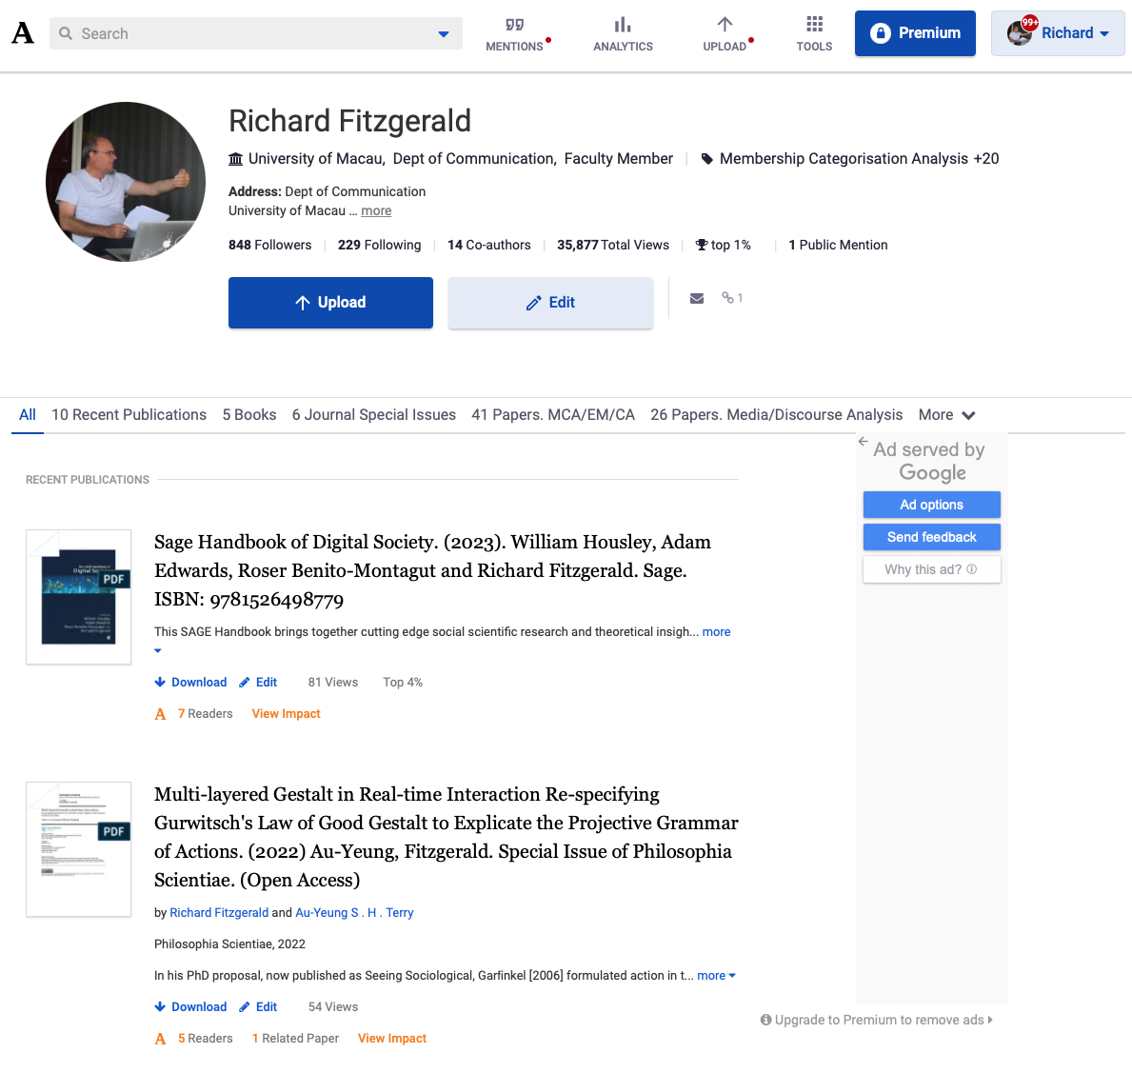
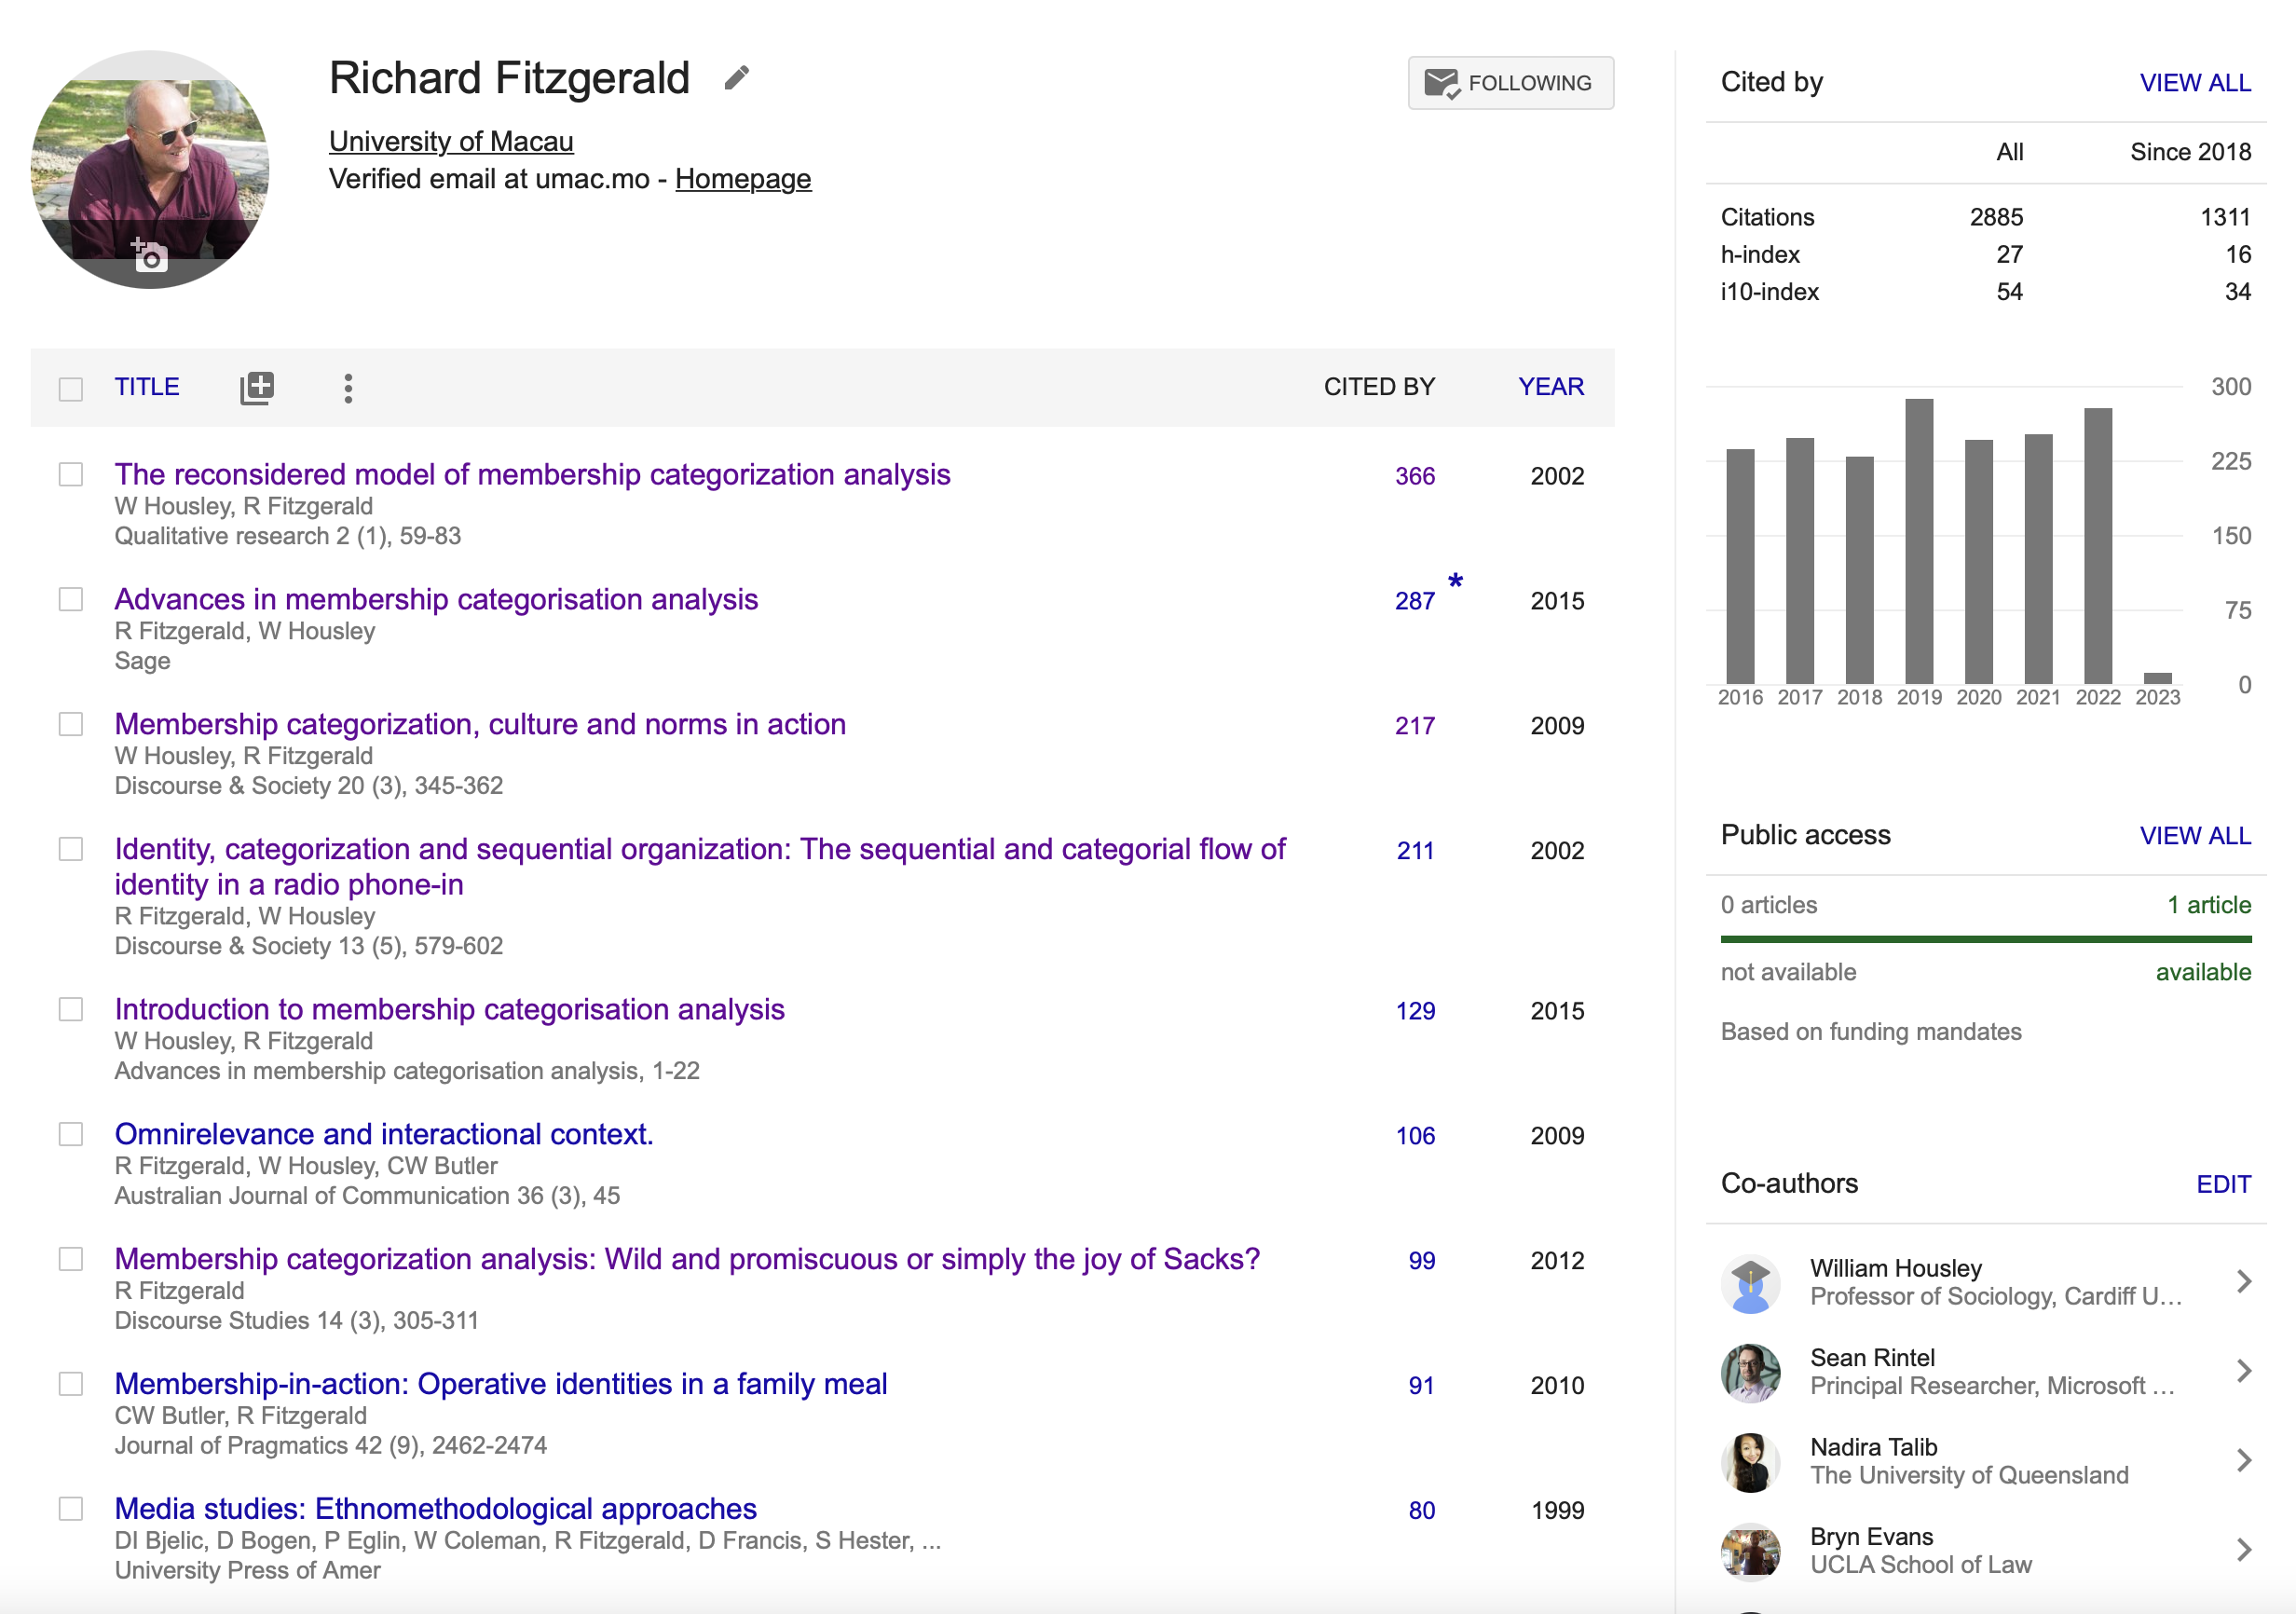
The Vainglorious Continued

Slide 26
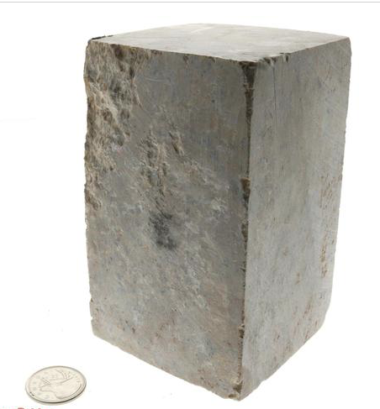
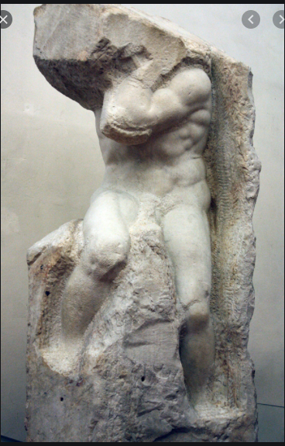
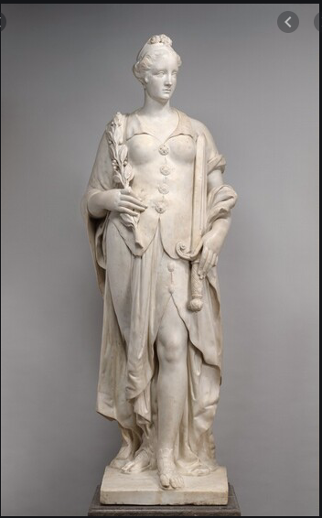
The Art of (academic) Writing
Research Data
Research Focus
Writing and Editing

Slide 27

The Topics.
Embarking on a Career as an Academic Author
The Anatomy of a Research Paper
The Art of the Literature Review
The Hidden Work of Analysis
Journal Publishing and Phd
The Art of an Abstract.
Journal Submissions
Reviews and Revisions
Conferences, Submissions and Presentations

Slide 28

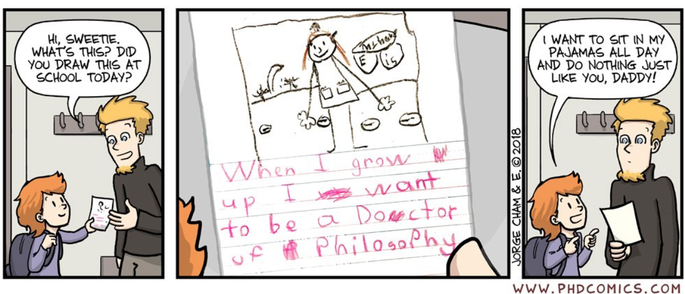
This is a long journey, keep a perspective
Lego Grad Student
https://legogradstudent.tumblr.com
PHD Comic.
https://twitter.com/PHDcomics?ref_src=twsrc%5Egoogle%7Ctwcamp%5Eserp%7Ctwgr%5Eauthor

Slide 29
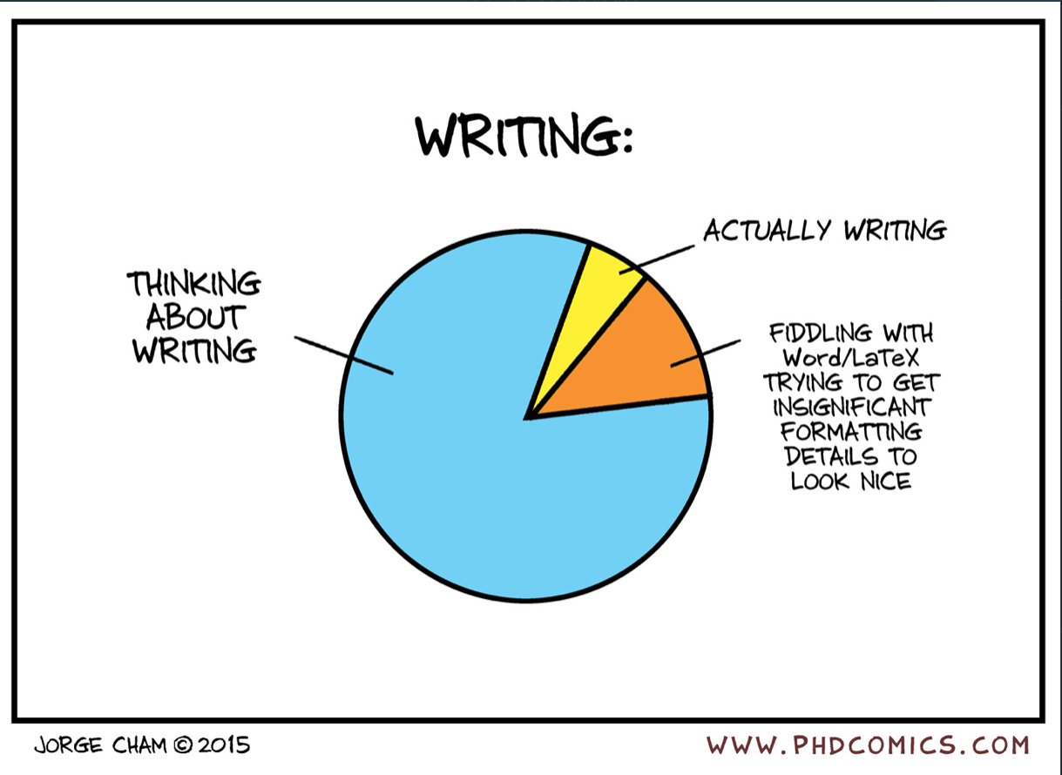
Academic time.

Slide 30
Contact and Moodle
Email – Rfitzgerald@umac.mo - Only short e mails are welcomed and will be responded to.
Long Emails – Avoid!– make an appointment – it is much better to talk face to face.
Phone – don’t
Room No. E21 2048
Office Hours –Monday 2pm to 3pm You can drop by at anytime – if I am in my office I may have time to talk I will be happy to.
Or to be sure of my time please make an appointment – By email.

